Slide 1
CS 2600 Computer Networks I Dr. Sayeed Sajal Lecture 18 Ethernet and Multiple Access Networks (802.3)

Slide 2
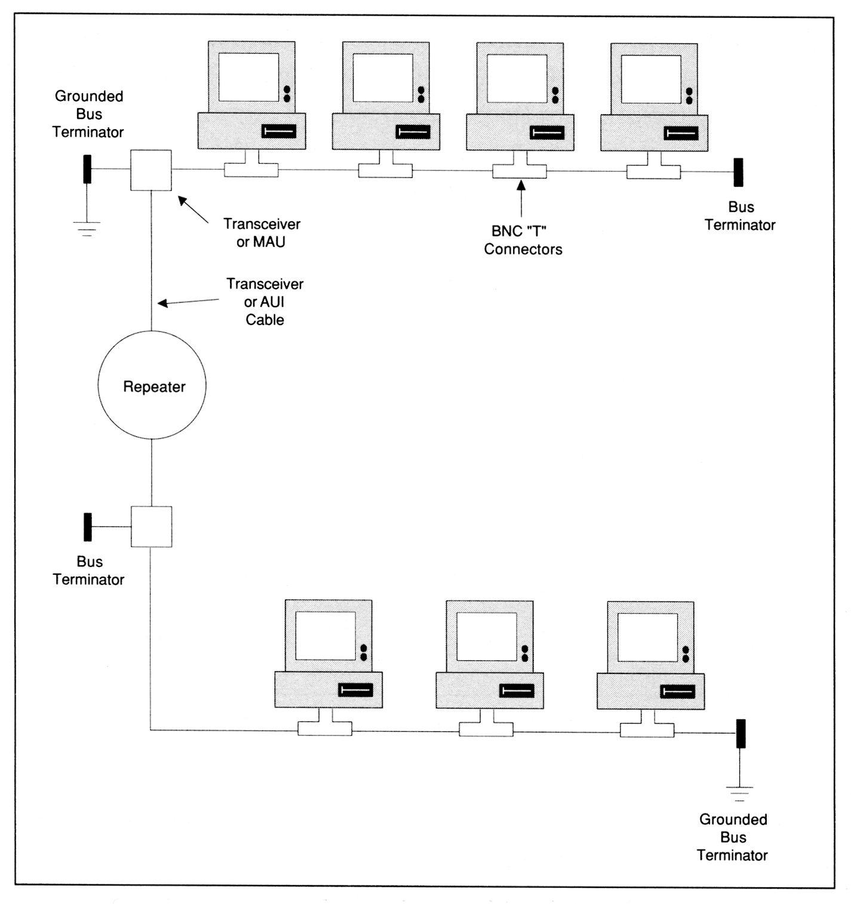
IEEE 802.3 10BASE2 (Thin Ethernet) Topology
Max 200m segments
From LAN Troubleshooting Handbook, 2nd Ed. by M. Miller (M & T Books)

Slide 3
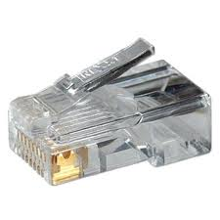
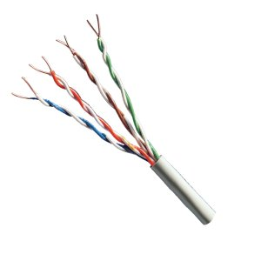
IEEE 802.3 10BASE-T Hub
RJ-45 connector
M
G
M
T
Unshielded
Twisted Pair Cable

Slide 4
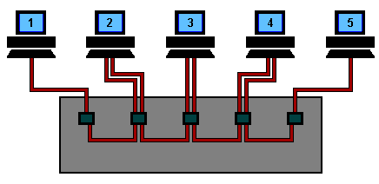
Ethernet Animation: Signal Flow with a Hub*
*Click the image to run the animation
http://www.datacottage.com/nch/eoperation.htm#.Um2CghDhL8o

Slide 5
10BASE-T Distributed Star Topology

Slide 6
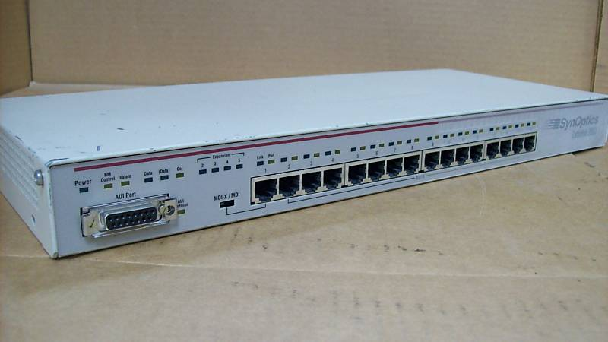
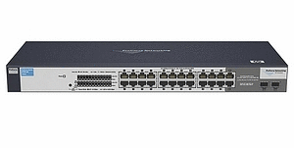
Ethernet Hub and Switch
SynOptics LattisHub 2803 16 Port Hub (1990)
HP ProCurve 1700-24 Ethernet Switch (2014)

Slide 7
Ethernet Type II Frame Format*
Type code indicates payload (08 00₁₆ = IPv4 packet)
*This is the more popular Dec/Intel/Xerox version of Ethernet, based on text Figure 2.25.
Most Internet IP packets use Type II frames.
†Also called EtherType

Slide 8
Some Ethernet Type Field Codes (Excerpted from https://www.iana.org/assignments/ieee-802-numbers/ieee-802-numbers.xhtml)
Ethernet Exp. Ethernet Description References
------------- ------------- ----------- ----------
decimal Hex decimal octal
0000 0000-05DC - - IEEE 802.3 Length Field [XEROX]
1500 05DC End of 802.3 Length Field
1536 0600 1536 3000 XEROX NS IDP [133,XEROX]
0660 DLOG [XEROX]
0661 DLOG [XEROX]
2048 0800 513 1001 Internet IP (IPv4) [IANA]*
2049 0801 - - X.75 Internet [XEROX]
2050 0802 - - NBS Internet [XEROX]
2051 0803 - - ECMA Internet [XEROX]
2052 0804 - - Chaosnet [XEROX]
2053 0805 - - X.25 Level 3 [XEROX]
2054 0806 - - ARP [IANA]
. . .
32923 809B - - Appletalk [XEROX]
. . .
33079 8137-8138 - - Novell, Inc. [XEROX]
. . .
34525 86DD IPv6 [IANA]
*Internet Assigned Numbers Authority (www.iana.org)

Slide 9
Ethernet Type II Frame Format
*The standard Ethernet Type II Maximum Transmission Unit (MTU) is 1500 bytes

Slide 10
IEEE 802.3 Frame Format

Slide 11
IEEE 802.3 Frame Containing 802.2 LLC Header
*Inclusion of the SNAP header reduces the MTU of the 802.3 frame to 1492 bytes (not important for this class)

Slide 12
IEEE 802 Relationships to OSI and Internet Models
← IEEE
Type II →

Slide 13
Some Ethernet Type Field Codes (Excerpted from https://www.iana.org/assignments/ieee-802-numbers/ieee-802-numbers.xhtml)
Ethernet Exp. Ethernet Description References
------------- ------------- ----------- ----------
decimal Hex decimal octal
0000 0000-05DC - - IEEE 802.3 Length Field [XEROX]
1500 05DC End of 802.3 Length Field
1536 0600 1536 3000 XEROX NS IDP [133,XEROX]
0660 DLOG [XEROX]
0661 DLOG [XEROX]
2048 0800 513 1001 Internet IP (IPv4) [IANA]
2049 0801 - - X.75 Internet [XEROX]
2050 0802 - - NBS Internet [XEROX]
2051 0803 - - ECMA Internet [XEROX]
2052 0804 - - Chaosnet [XEROX]
2053 0805 - - X.25 Level 3 [XEROX]
2054 0806 - - ARP [IANA]
. . .
32923 809B - - Appletalk [XEROX]
. . .
33079 8137-8138 - - Novell, Inc. [XEROX]
. . .
34525 86DD IPv6 [IANA]

Slide 14
Several Ways of Representing the Same Ethernet MAC (“Hardware”) Address
Manufacturer’s extension
Traditional: 00:1c:b1:98:02:03
Abbreviated: 0:1C:B1:98:2:3
Cisco-style: 001c.b198.0203
Wireshark-style: Cisco_98:02:03
IEEE/IANA/Microsoft-style: 00-1c-b1-98-02-03
OUI* (“manufactured by Cisco”)
OUI translated to manufacturer name by Wireshark
*IEEE Organizational Unit Identifier – specifies the manufacturer

Slide 15
IEEE Ethernet Vendor Organizational Unit Identifiers* (Excerpted from http://standards-oui.ieee.org/oui/oui.txt)
OUI Organization
company_id Organization
Address
00-00-AA (hex) XEROX CORPORATION
0000AA (base 16) XEROX CORPORATION
OFFICE SYSTEMS DIVISION
M/S 105-50C 800
PHILLIPS ROAD
WEBSTER NY 14580
00-00-C0 (hex) WESTERN DIGITAL CORPORATION
0000C0 (base 16) WESTERN DIGITAL CORPORATION
8105 IRVINE CENTER DRIVE
IRVINE CA 92718
00-1C-B1 (hex) CISCO SYSTEMS, INC.
001CB1 (base 16) CISCO SYSTEMS, INC.
170 W. TASMAN DRIVE M/S SJA-2
SAN JOSE CA 95134-1706 UNITED STATES
00-AA-00 (hex) INTEL CORPORATION
00AA00 (base 16) INTEL CORPORATION
5200 NE ELAM YOUNG PARKWAY
HILLSBORO OR 97124
*See also http://www.base64online.com/mac_address.php for an OUI search tool

Slide 16
Ethernet Broadcast and Multicast MAC Addresses
Broadcast: ff:ff:ff:ff:ff:ff
General Multicast: 01:xx:xx:xx:xx:xx
IPv4 Multicast: * 01:00:5E:xx:xx:xx
IPv6 Multicast: * 33:33:xx:xx:xx:xx
*These are not IP multicast addresses, but they would be the destination MAC address in the header of an Ethernet frame that carries an IPv4 or IPv6 packet with an IP multicast destination address.

Slide 17
Overview of Wireshark Lab 3
If you’re using your own Windows computer, you’ll need to install Wireshark and Npcap in a single installation process (both are open source software)
For macOS and Linux, you’ll install Wireshark only
Follow the installation directions in Lab 3 (don’t improvise)
You’ll need broadband Internet access via Ethernet (preferred) or WiFi, or an Ethernet connection to another computer. (Or just use the Network Lab in CS 516.)
Allow an hour or so for this lab exercise

Slide 18
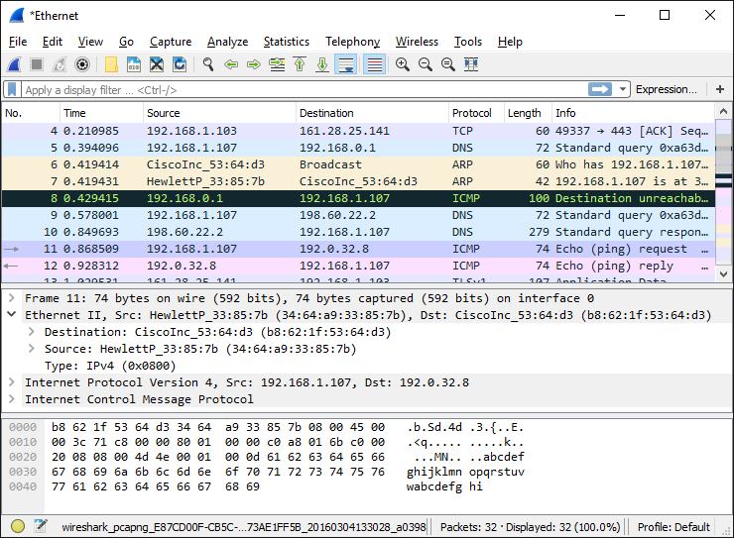
Dissecting an Ethernet Type II Frame in Wireshark
Ethernet header
(Not captured)
(Not captured)

